Slide 1
GUIDE TO COMPETING
USA Climbing Competitions

Slide 2
Agenda:
-How competing works
-QE’s, regionals,
- age categories etc.
-Schedule
-memberships
-different types of competitions
-USAC competitor and parent guide to competing

Slide 3
How Does Competing Work?
The youth climbing competitions Movement team members participate in are run by USA climbing.
USA Climbing Competitions are split up into two seasons: Bouldering and Ropes
There are four levels of Competitions in both seasons: Qualifying events, then the Regional, Divisional, and National Championships
ACCESS THE USAC RULEBOOK HERE

Slide 4
Vocabulary to know.
Beta: advice, direction, or instruction on how to complete a climb
Onsight: climbing a boulder or route without any prior information, and without seeing anyone else climb it.
Flash: climbing a boulder or route on your first time with beta or after seeing someone else climb it.
ISO: Isolation, area climbers enter in an onsight format competition so they cannot get information about the climbs prior to starting them. Only athletes and coaches are permitted to enter ISO
4 point start: normal boulder problems have a start marked for only where your two hands must begin the climb. 4 point starts indicate where your hands and feet must start the climb.
Control: A competitor is given control of a hold
Zone:
Top:

Slide 5
Season Overview
Bouldering
October 14th until December 9th.
Bouldering Regionals:
Saturday or Sunday January 13th/14th (Location TBD)
Bouldering Divisionals
Saturday and Sunday February 10-11
Lead/Top Rope
Lead and top rope, which runs, roughly, from February 25th through May 11th.
Regionals
Saturday or Sunday May 11/12
Divisionals
Saturday and Sunday June 15-16
Speed
Let us know if you are interested in learning more about speed climbing…

Slide 6
What is a Qualifying Event?
Qualifying Events
Local level of competitions
Only competitors from region 12
Mostly modified redpoint competition formats (no isolation, athletes can speak to coaches during competition and they can watch each other climb)
You can have a competitor ($110) or an Introductory membership ($35)

Slide 7
Championships
Regional Championship
Divisional Championship
National Championship
Climbers who place in the top 26 in the region after the Qualifying events can compete at the regional championship.
Onsight format (isolation area for climbers prior to competition)
All age categories
Top 13 athletes from each age category in each region get an invite to divisionals
Only C,B,A,Jr compete at Divis, youth D’s are not invited to compete
2 day event, qualification and final rounds
Top 6 competitors from each age category from each division are invited to nationals
All categories except D

Slide 8
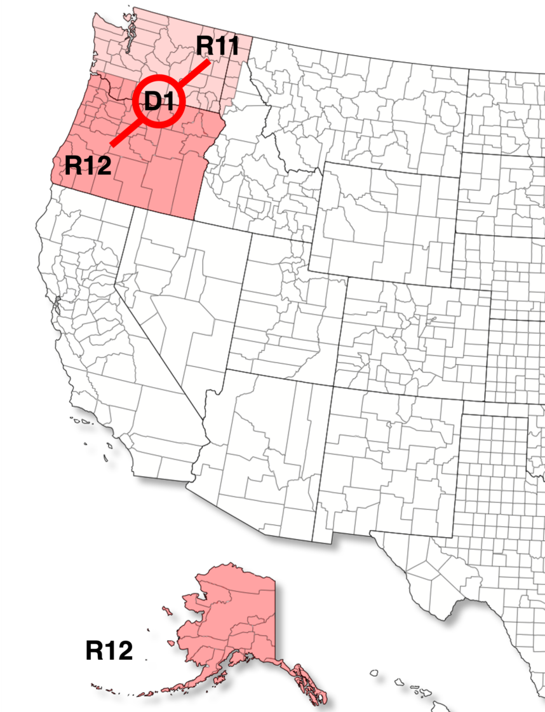
What is our division?
Find our region’s website here: https://usaclimbing.org/compete/region-12/

Slide 9
COMPETITION FORMATS
Modified Redpoint (QE format) | Onsight (championship format) | Flash
-Competitors may only climb boulders/routes assigned to their category. All boulders/routes for a category are used to determine the scores; therefore competitors should make an effort to try all of them. -After selecting a boulder/route they want to climb, they wait in a line for their turn to make an attempt -Competitors may watch other competitors climb the boulders/routes -Competitors may share and receive “beta” (information about the climb) before or after, but not during their attempt -Their result on the attempt is recorded by the judge assigned to that boulder/route -If they do not top the climb, competitors may return to attempt it again later during the session -The number of attempts per boulder/route may be limited; this will be listed in the competition Info Sheet | -Each category is assigned a set of boulders/routes, which competitors are prohibited from viewing prior to the competition -Competitors in a category are required to enter the isolation (ISO) area by a certain time, which is published in the competition Info Sheet -Registered competitors are randomly assigned to a starting order in their category with a corresponding start time; this is typically published a day or two prior to the event -Competitors come out of ISO one-at-a-time to climb the boulders/routes in a set order; they will have a fixed amount of time to attempt each one, with a transition and rest period between each boulder/route -Competitors may not share or receive beta about a climb at any time prior to or during the competition | Used only at Lead/Top Rope competitions Each category is assigned a set of routes Registered competitors are randomly assigned to a starting order in their category with a corresponding start time for each route Competitors are provided access to pre-recorded videos of the routes being climbed by members of the routesetting team Competitors may watch other competitors climb the routes Competitors may share and receive beta about a climb before and after, but not during their attempt Competitors are allowed a single attempt on a route and must complete their attempt within the allotted maximum climb time Competitor will have a minimum rest period between routes

Slide 10
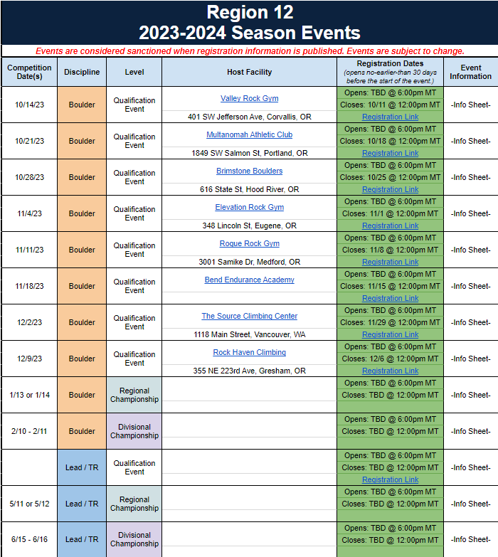
2022-2023 Competition Schedule (tentative)

Slide 11
Age Categories
Athletes are placed into categories based on their birth year and gender. A competitors category will start with their gender, followed by their age group. For example Female Youth A. The age categories are listed below.
Birth Year | Age Category For the 2023-2024 Season
2005 or 2006 | Junior
2007 or 2008 | Youth A
2009 or 2010 | Youth B
2011 or 2012 | Youth C
2013 or younger | Youth D

Slide 12
How do I register my child?
In order to compete, your child needs a USA Climbing membership. USA Climbing offers two options for memberships which include a Competitor Membership or an Introductory Membership.
Introductory Membership:
A cheaper option for those just starting out and not looking to compete at the regional level
Allows your athlete to compete in qualifying events, but not at regionals
Costs $35
ONLY CHOOSE THIS OPTION IF YOU ARE SURE YOUR ATHLETE IS NOT GOING TO COMPETE AT REGIONALS
Competitor Membership:
Allows your child to compete in both Qualifying Events, as well as all the way up to the National level
Costs $110
Membership can be purchased at usaclimbing.sport80.com

Slide 13
Volunteering
An integral part of the Youth competition series is volunteering. Even if you don’t have any climbing or competition experience, there is always a way for you to help out.
Volunteering is also a great way to gain a deeper understanding of the rules and expectations of a competition.
We would to see more families active with volunteering.
There are a lot of jobs to do, so it takes a village.

Slide 14
How does scoring work?
For boulders athletes are ranked based on the below information :
Total Number of Tops
Total Number of Zones
Total Number of Low Zones
Total Number of Attempts to Top
Total Number of Attempts to Zone
Total Number of Attempts to Low Zone
For example, Bryce got 3 tops and 4 zones and it took her 8 attempts to get the 3 tops and 10 attempts to get the 4 zones, however, Claudia got 4 tops and 4 zones so regardless of attempts Claudia places higher than Bryce because she was able to get a top on one more climb then Bryce.

Slide 15
Rules parents should know.
There are a lot of rules. We promise that we will get athletes to understand these rules before competitions. Parents do not need to know all of the rules.
In all competitions formats, athletes cannot receive any beta from parents or coaches while they are on the wall climbing. In Onsight format competitions, parents should refrain from talking to their athletes until the competitor is completely done climbing.
Acceptable phrases to cheer on your athlete include, lets go Bryce! You got this Bryce!
Please don’t say “Breath Bryce,” “thats it bryce” “just go for it!” etc
Athletes must fully establish a 4 point start in order for their progress up the climb to be valid. If you are curious about what a 4 point start looks like.
Please please please take a clear continuous video of your athletes entire 4 minutes of climbing during a competition. Or take a video of the whole attempt on a route. This helps us to make score appeals if needed.

